Slide 1
Fuzzy vs Crisp

Slide 2
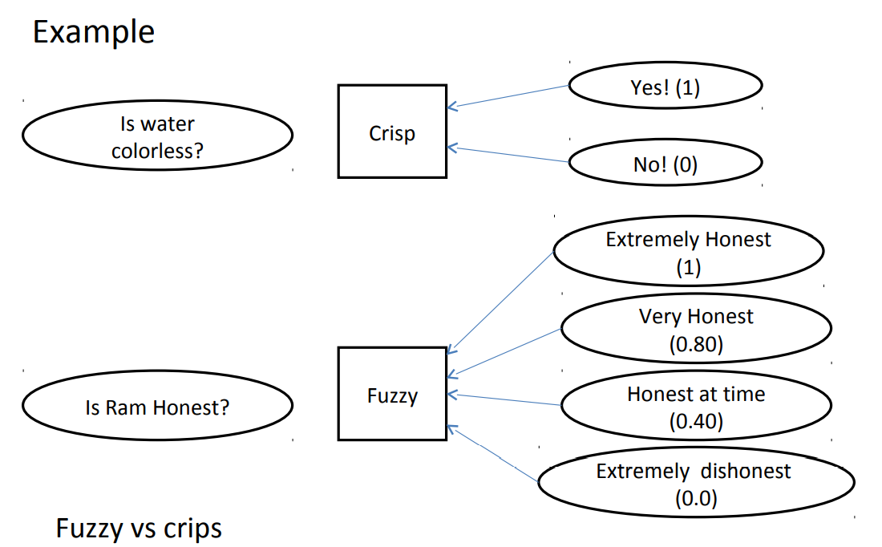

Slide 3
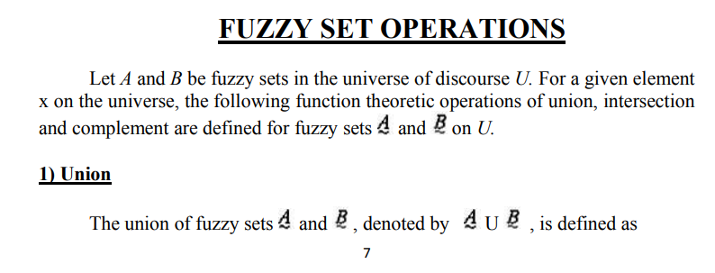

Slide 4
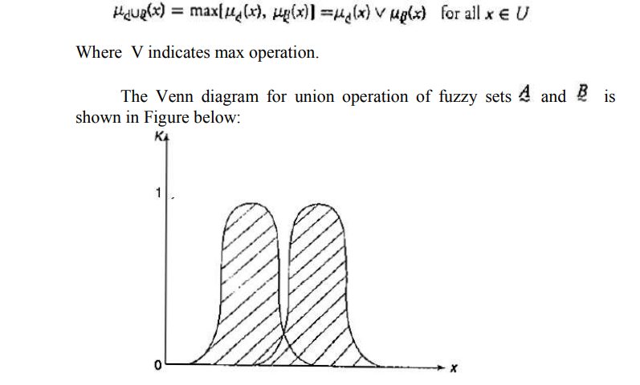

Slide 5
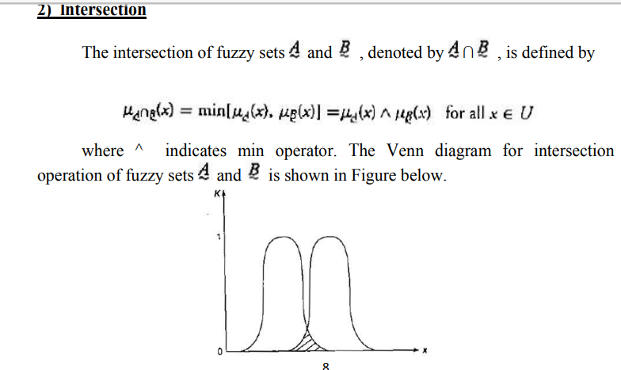

Slide 6
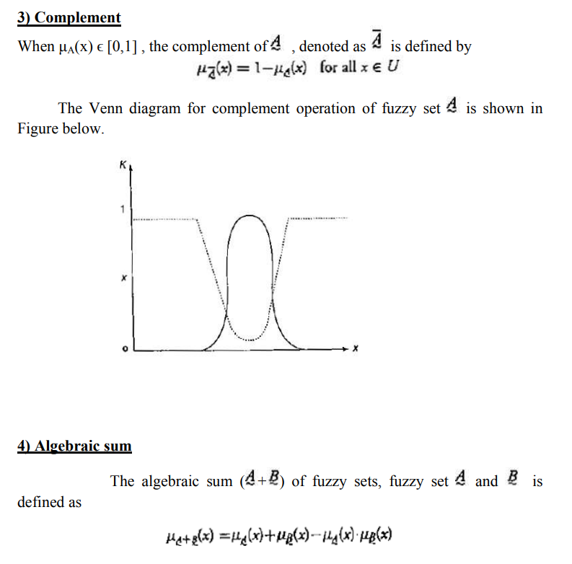

Slide 7
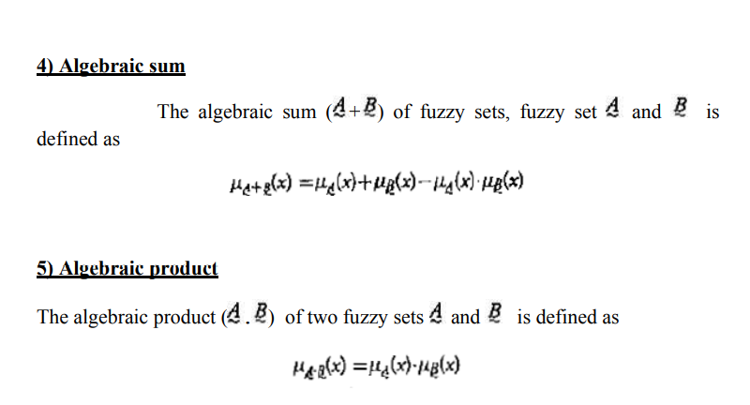

Slide 8
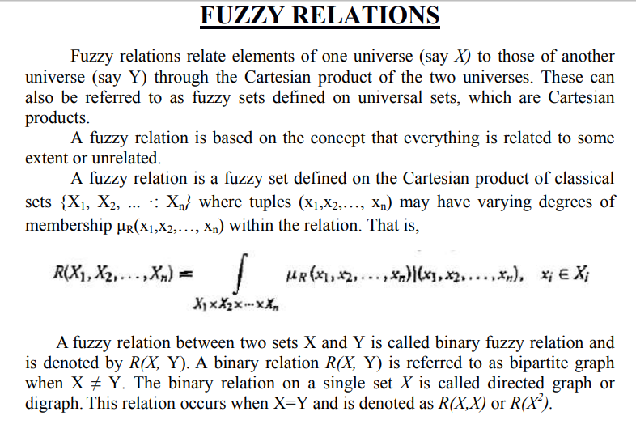

Slide 9
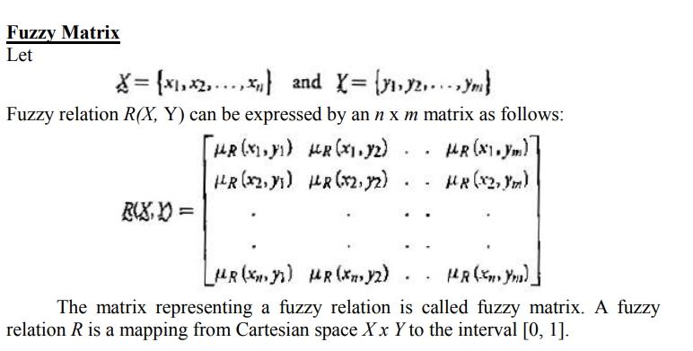

Slide 10
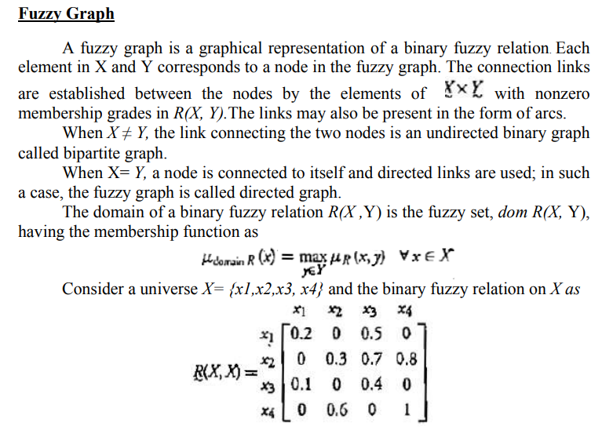

Slide 11
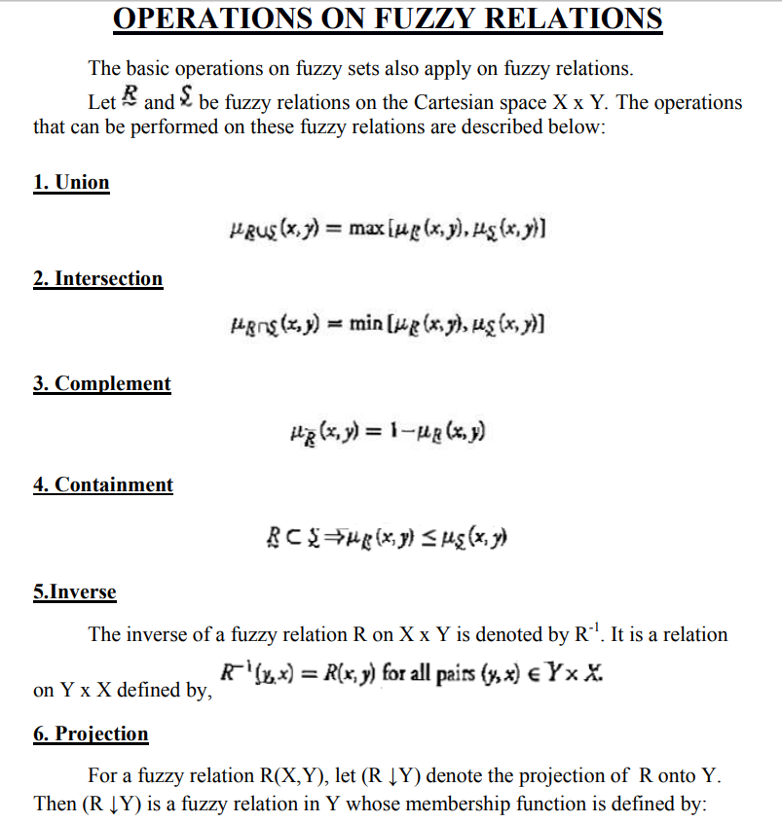

Slide 12
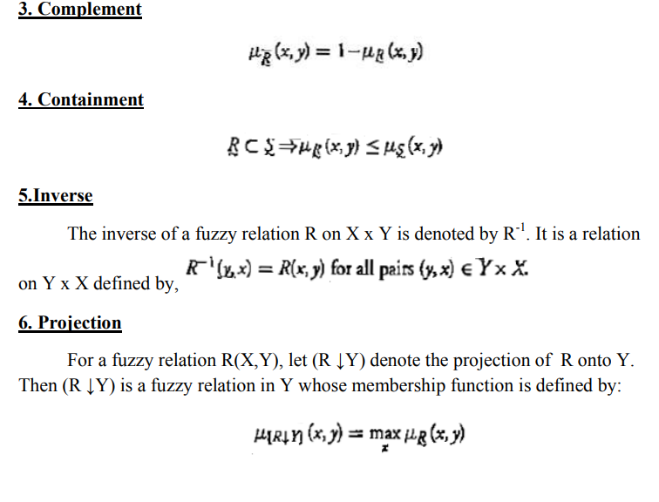

Slide 13
Fuzzy Set Operation Examples

Slide 14
Given X to be the universe of discourse and Ã and to Ḃ be fuzzy sets with µA (x) and µB (x) are their respective membership function, the fuzzy set operations are as follows:
Union: µA U B(x) = max (µA (x), µB (x))
Intersection: µA ∩ B(x) = min (µA (x), µB (x))
Complement: µA (x) =1- µA (x)

Slide 15
Example:
A = {(x1 ,0.5),(x2 ,0.7),(x3 ,0)}
B = {(x1 ,0.8),(x2 ,0.2),(x3 ,1)}
Union: A U B = {(x1 ,0.8),(x2 ,0.7),(x3 ,1)}
Because µA U B(x1 ) = max (µA (x1 ), µB (x1 ))
= max(0.5,0.8)
= 0.8
µA U B(x2 ) = 0.7 and µA U B(x3 ) = 1

Slide 16
Example:
A = {(x1 ,0.5),(x2 ,0.7),(x3 ,0)}
B = {(x1 ,0.8),(x2 ,0.2),(x3 ,1)}
Intersection: A ∩ B = {(x1 ,0.5),(x2 ,0.2),(x3 ,0)}
Because µA ∩ B(x1 ) = min (µA (x1 ), µB (x1 ))
= max(0.5,0.8)
= 0.5
µA ∩ B(x2 ) = 0.2 and µA ∩ B(x3 ) = 0

Slide 17
Example:
A = {(x1 ,0.5),(x2 ,0.7),(x3 ,0)}
Complement: A c = {(x1 ,0.5),(x2 ,0.3),(x3 ,1)}
Because µA (x1 ) =1- µA (x1 )
= 1 – 0.5
= 0.5
µA (x2 ) = 0.3 and µA (x3 ) = 1

Slide 18
Fuzzy Logic
In crisp logic, the truth values acquired by propositions or predicates are 2-valued, namely True, False which may be treated numerically equivalent to (0, 1). However, in fuzzy logic, truth values are multivalued such as absolutely true, partly true, absolutely false, very true, and so on and are numerically equivalent to (0-1).

Slide 19
Fuzzy Propositions
A fuzzy proposition is a statement which acquires a fuzzy truth value. Thus, given P’ to be a fuzzy proposition, T(P’) represents the truth value (0-1) attached to P. In its simplest form m, fuzzy propositions are associated with fuzzy sets. The fuzzy membership value associated with the fuzzy set A’ for P’ is treated as the fuzzy truth value T(P’).
T(P’) = μ_{A’}(x) where 0 ≤ μ_{A’} (x) ≤1
P’: Ram is honest.
T(P’) = 0.8, if P’ is partly true.
T(P’) = 1, if P’ is absolutely true.

Slide 20
Fuzzy Connectives
Fuzzy logic similar to crisp logic supports the following connectives:
Negation : −
Disjunction : or
Conjunction : and
Implication : =>

Slide 21
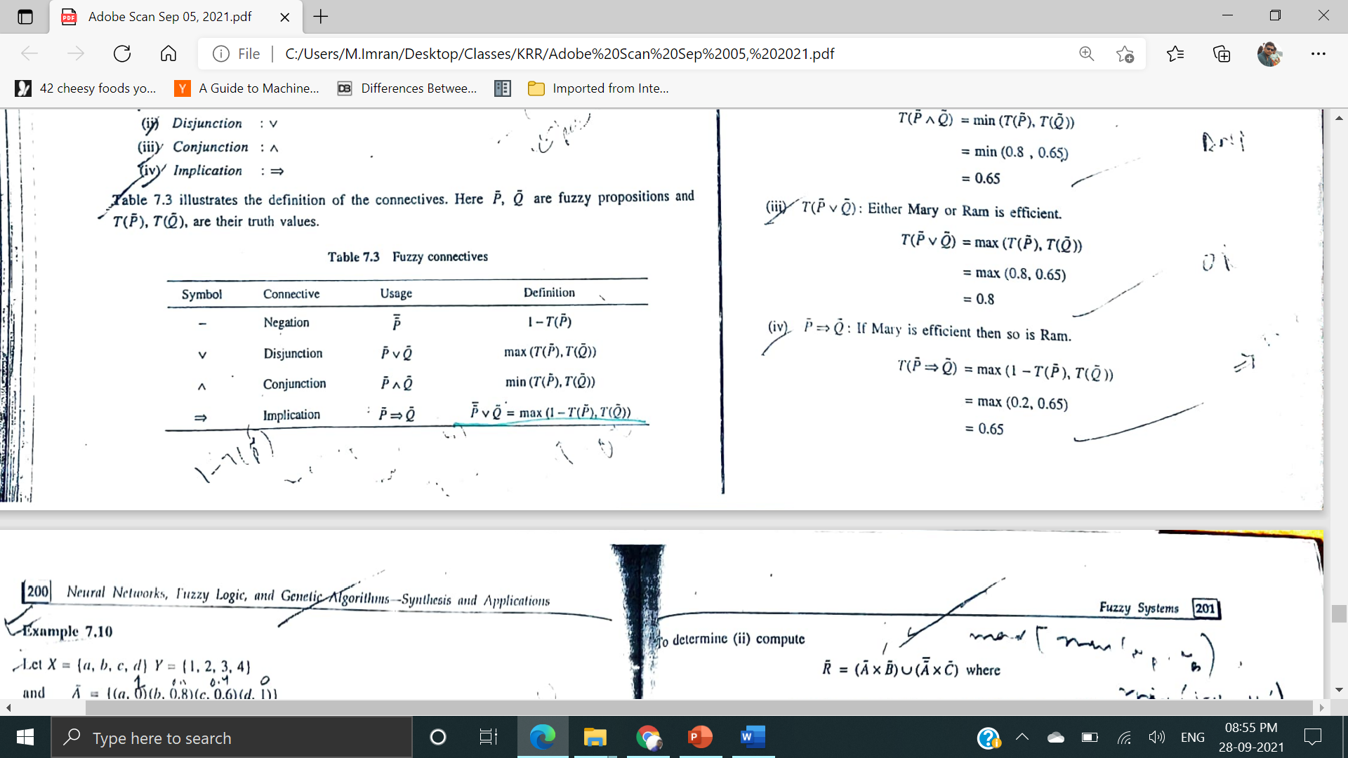

Slide 22
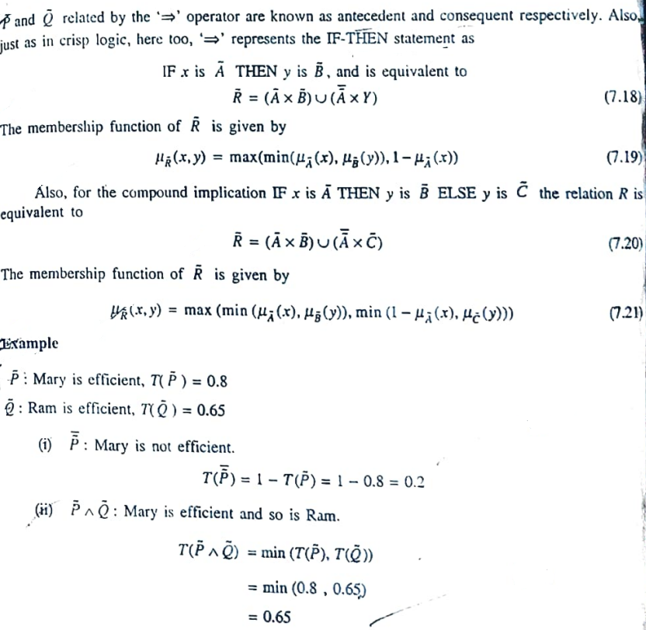

Slide 23
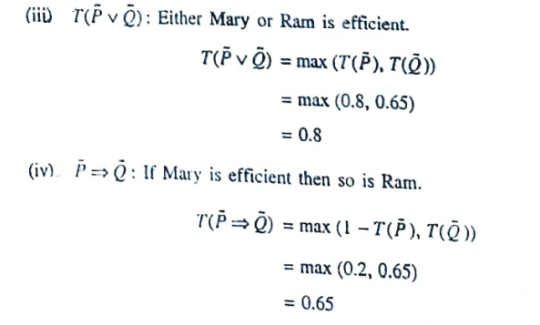

Slide 24
Fuzzy Quantifiers
Just as in crisp logic where predicates are quantified by quantifiers, fuzzy logic propositions are also quantified by fuzzy quantifiers. There are two classes of fuzzy quantifiers such as:
Absolute quantifiers
Relative quantifiers
While absolute quantifiers are defined over Ʀ, relative quantifiers are defined over (0-1)

Slide 25
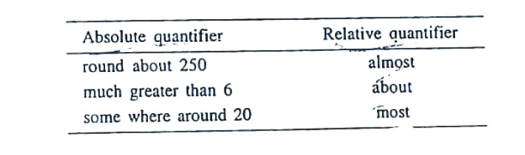

Slide 26
Fuzzy Inference
Fuzzy inference also referred to as approximate reasoning refers to computational procedures used for evaluating linguistic descriptions. The two important inferring procedures are
Generalized Modus Ponens (GMP)
Generalized Modus Tollens (GMT)

Slide 27
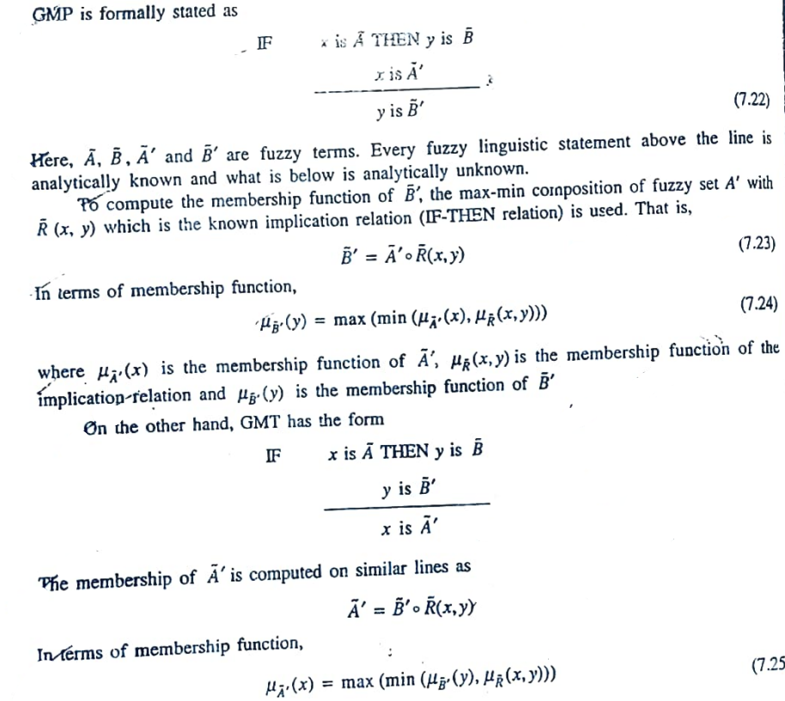

Slide 28
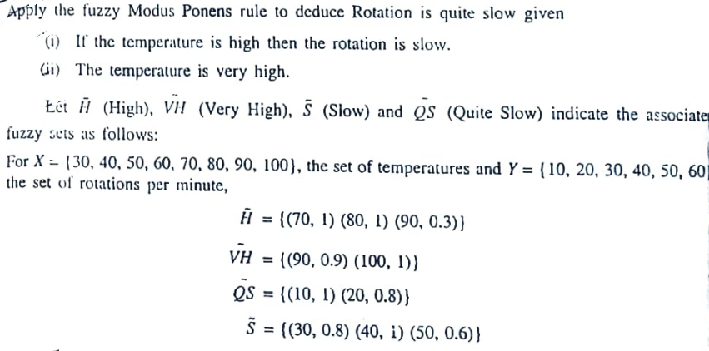

Slide 29
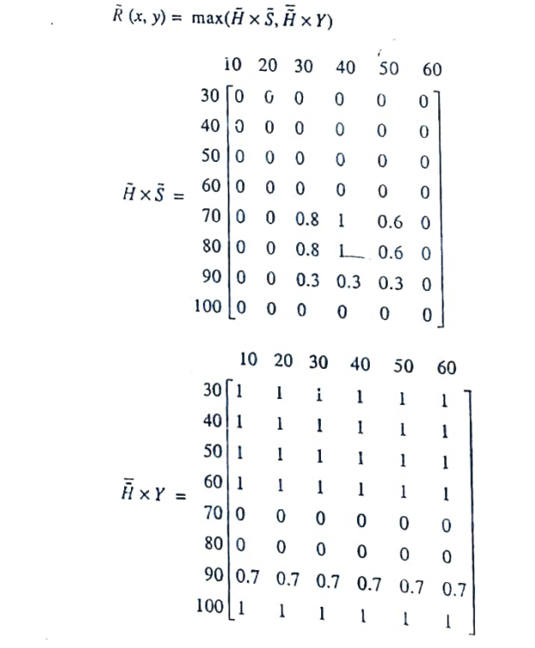

Slide 30
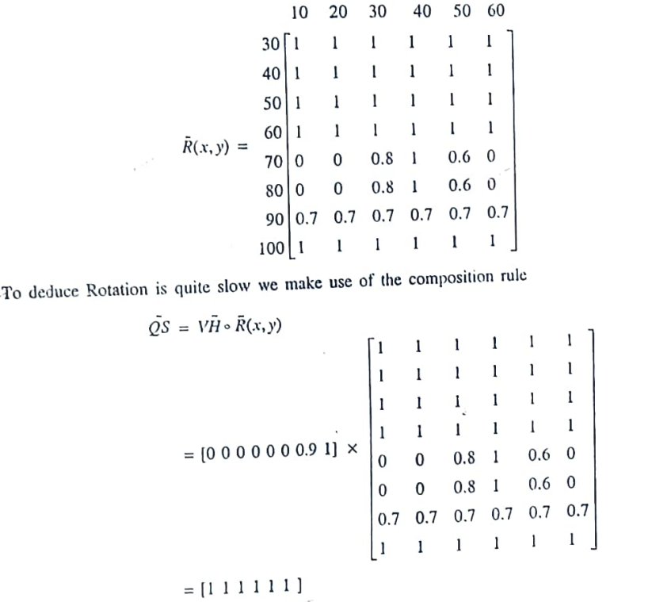

Slide 31

Fuzzy Rule Based System
Fuzzy linguistic descriptions are formal representations of systems made through fuzzy IF-THEN rules. They encode knowledge about a system in statements of the form-
IF (a set of conditions) are satisfied THEN (a set of consequents) can be inferred. Fuzzy IF-THEN rules are coded in the form.

Slide 32
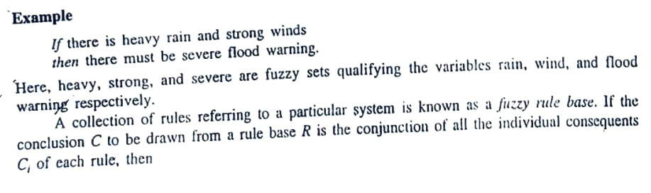
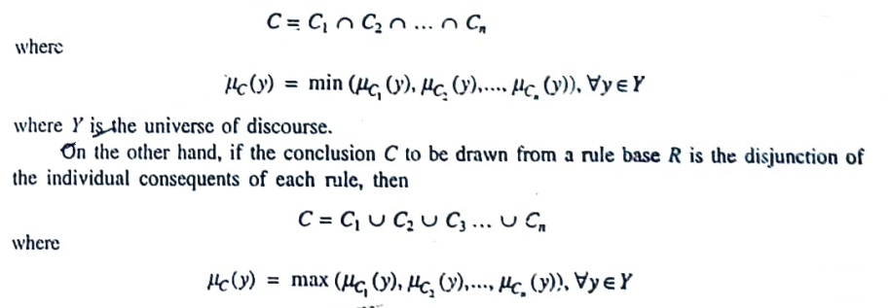

Slide 33
Defuzzification
In many situations, for a system whose output is fuzzy, it is easier to take a crisp decision if the output is represented as a single scalar quantity. This conversion of a fuzzy set to single crisp value is called defuzzification and is the reverse process of fuzzification

Slide 34
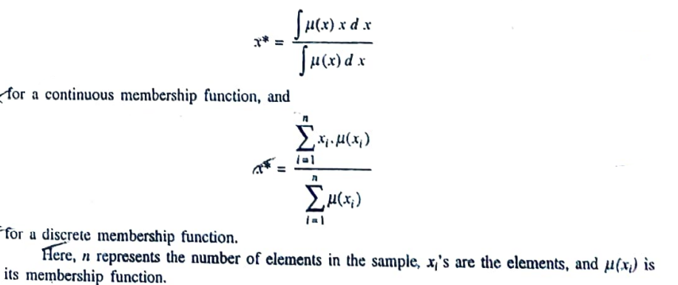
Defuzzification Methods
Centroid Method
Also known as the center of gravity or the center of area method, it obtains the center of area (x*) occupied by the fuzzy set. It is given by the expression

Slide 35
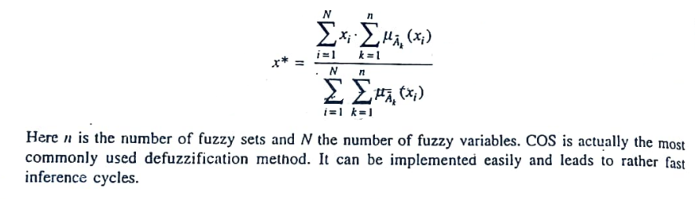
Centre of Sums
In the centroid method, the overlapping area is counted once whereas in center of sums, the overlapping arca is counted twice. COS builds the resultant membership function by taking the algebraic sum of outputs from each of the contributing fuzzy sets A’₁, A’₂., etc. The Defuzzified value x * is given by

Slide 36
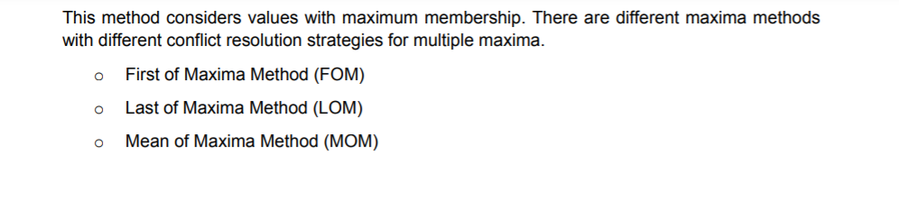

Slide 37
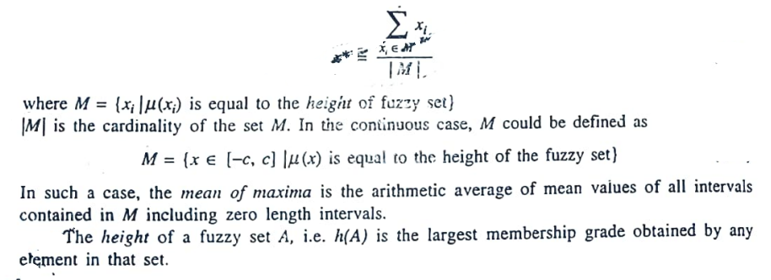
Mean of maxima
One simple way of defuzzifying the output is to take the crisp value with the highest degree of membership. In cases with more than one element having the maximum value, the mean value of the maxima is taken. The equation of the defuzzified value x* is given by

Slide 38
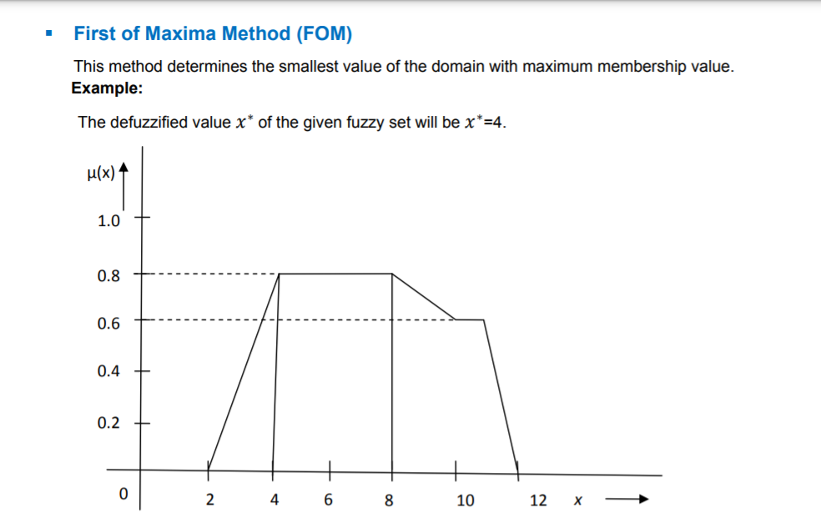

Slide 39
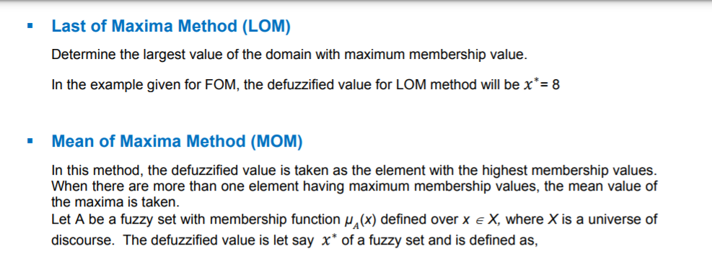

Slide 40
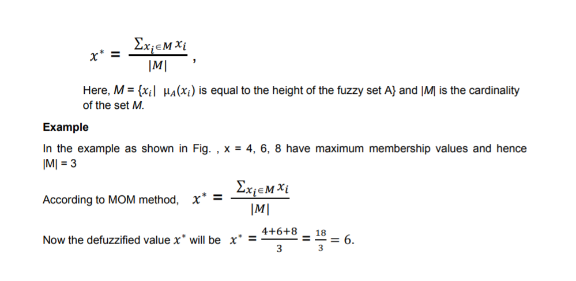

Slide 42
Application

